Slide 1

Forecasting under COVID: when simple works - and when it doesn’t
useR!, 5–9 July, 2021
Dr. Maryam Shobeirinejad, Transurban
Email: mshobeirinejad@transurban.com
Twitter: @m_shobeirinejad

Slide 2
Forecasting during COVID-19 made us humble
Our ways of working had to change
Our forecasting world
Many stakeholders and high need for subject matter expertise
We require a high level of interpretability and accuracy
Fast-moving corporate environment
High uncertainty
Testing large no. of models
Reproducibility
Versioning
Communicating outcomes
Increasing collaboration
Quick updates
Minimising error
Success looks like:
High accuracy
Interpretability
Subject matter expertise
Ability to rapidly respond to changing environment
Team Challenges

Slide 3
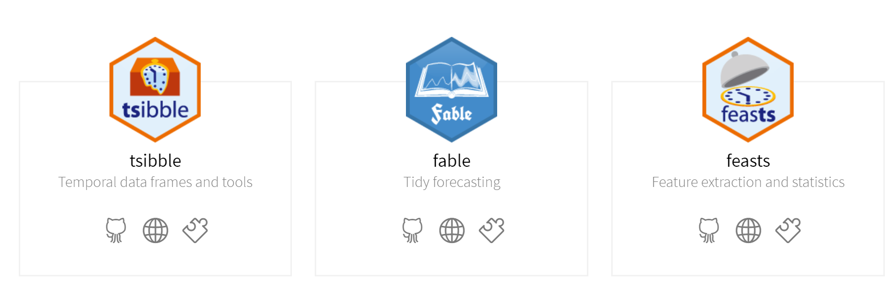

Our ecosystem was built to efficiently reuse our work
We reduced risk and increased communication by creating a streamlined process
Approach / Tools
Project specific
Reusable processes
Project repository
(Manage inputs / outputs and calculations
.Rmd, .csv, .xlsx)
Package development
Data collection/processing
Model specifications in specialized .xlsx templates
Timeseries analysis/plots
Github Versioning / Documentation (Readme files, Data dictionaries, package versions)
Leveraging tidyverts ecosystem
Conclusions
Communicating
Combining tool chains gave us the flexibility we needed
Out toolchain explicitly built for maximizing collaboration
Extra flexibility of state space switching helped managing impacts of 2020
.Rmd
Shiny
Tableau

Slide 4
Thank you!

